Slide 1

HDO (and H₂O/D₂O) quenching rates
Theory & experiments

Slide 2

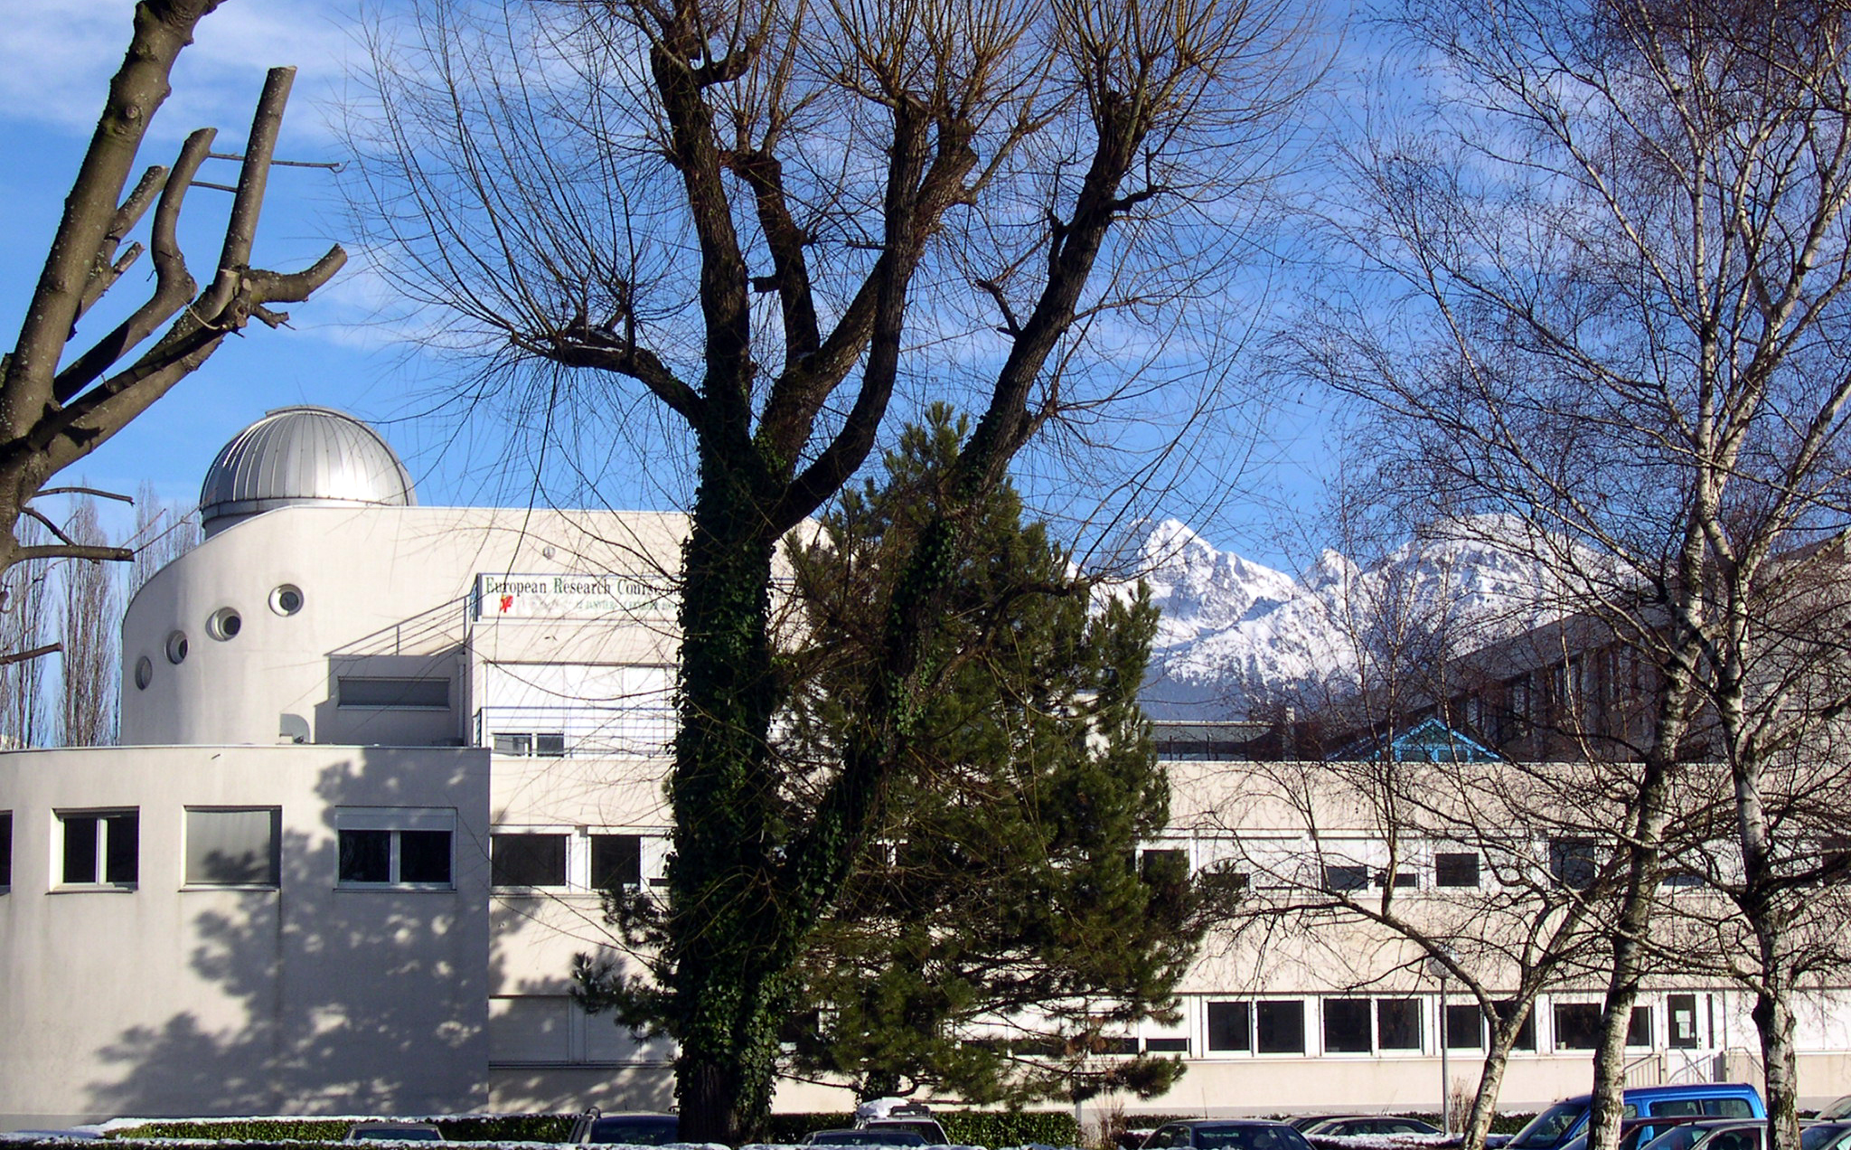
A venture of IPAG and several institutes in France and worldwide
L. WIESENFELD, A. FAURE, C. CECCARELLI,
C Kahane, C Rist N. Troscompt, M. Wernli
Meudon, Le Havre, Dijon, Lille,
Rennes, Bordeaux
Nijmegen (NL), JPL-Pasadena (US),
Durham (UK)
Also: ML Dubernet, F Daniel
€ :
EU FP6 ‘Molecular Universe’,
CHESS KP HSO CNES,
ANR FORCOMS
COST ‘ The Chemical Cosmos’, PCMI-INSU-CNRS, LABEX OSUG@2020, NWO

Slide 3
Collisional quenching/excitation :What is the physical process?
Rotational quenching (& fine structure, hyperfine, ro-vibrational quenching) :
Transfer between projectile and target of
kinetic energy /angular momentum (external and/or internal)
+ transient polarization
J₂
l
J₁

Slide 4
Level populations
Levels and Temperature; Equilibrium with the photon gas or the buffer gas
Out of equilibrium : no T. Competition between photon interactions and collisions
Energy
Energy
J=3
■
T
■
no T
P = exp(-E/kT)
J=2
■
■
Super cooling
J=1
■
■
J=0
■
■
Population
Population

Slide 5
Dividing point: critical density
Spontaneous emission (s⁻¹)
Collision rates
(cm³ s⁻¹)

Slide 6
Potential energy surface:
Water–molecular hydrogen van der Waals interaction
Full 9D PES,with
  High precision 5D PES (rigid monomers), at CCSD(T)+ R12 corrections
  Extrapolation for R > 15 A
  Expansion around equilibrium points (x-x_{eq})^{n}, n=2,3
  Average over v=0 ground state wave function : V(average), 5D
  Average over v>0 wave functions : collision with excited H₂O (or H₂)
  <v=1 | V | v=0> matrix elements : vibrational quenching
  Valiron et al JCP, 2005 and 2009.
  Monomer water : Kyro Hamiltonian, …

Slide 7
Rotational levels
H₂O, HDO, D₂O
H₂O
HDO
D₂O

Slide 8
Using the full PES
Property | Isotope | Calculation
Cross section, rotational excitation | H₂O –H₂ | Quantum/ semi-classical
Rates | H₂O –H₂ | Quantum
 |  | Classical/statistical
Cross sections,rates | HDO – H₂ | Quantum
 | D₂O | Quantum
Differential Cross Section | H₂O – H₂ | Quantum
 | HDO-H₂; D₂O – H₂ | Quantum
 | H₂O – D₂ | Quantum
Pressure Broadening | H₂O – H₂ | Quantum
Vibrational excitation | H₂O – H₂ | Classical, quantum

Slide 9
Cross sections, HDO-H₂
  σ (E_{collision})
Ortho H₂ j=1
Para H₂ j=0,2
LW et al, PCCP, JCP, & MNRAS, 2011,2012

Slide 10
Cross sections, HDO-H₂
  σ (E_{collision})
Ortho H₂ j=1
Para H₂ j=0,2
LW et al, PCCP, JCP, & MNRAS, 2011,2012

Slide 11
One example of rates
LW et al, PCCP, JCP, & MNRAS, 2011,2012

Slide 12
The file… as in LAMDA :
To be used in radiation transfer codes.
HDO rates; ortho H2, J=1
i f 4 10 20 30 40 50 60 70 80 90 100
2 1 68.70 65.50 55.87 48.09 42.38 38.14 34.93 32.41 30.40 28.76 27.40
3 1 61.94 83.57 94.97 101.74 107.44 112.19 115.99 118.95 121.23 122.96 124.26
3 2 64.48 78.22 75.16 67.86 61.19 55.68 51.18 47.46 44.37 41.75 39.51
4 1 7.28 10.98 10.77 9.47 8.23 7.20 6.36 5.67 5.11 4.63 4.23
4 2 112.91 180.29 212.04 223.60 229.98 233.84 236.04 237.09 237.33 236.99 236.26
4 3 51.15 71.42 71.53 67.06 62.82 59.21 56.15 53.52 51.24 49.25 47.49
5 1 17.30 20.70 21.41 21.50 21.63 21.78 21.91 22.02 22.12 22.21 22.29
5 2 35.26 42.49 42.03 40.16 38.60 37.31 36.22 35.29 34.48 33.78 33.17
5 3 102.42 125.31 129.32 127.62 125.08 122.13 119.04 115.95 112.96 110.13 107.46
5 4 49.04 51.33 47.62 44.29 41.67 39.49 37.60 35.95 34.49 33.19 32.04
6 1 5.98 7.58 8.37 8.97 9.37 9.63 9.80 9.91 9.99 10.04 10.07
6 2 71.93 86.73 93.27 100.90 107.12 111.70 115.00 117.39 119.12 120.40 121.35
6 3 35.88 41.20 39.63 38.56 37.62 36.68 35.77 34.90 34.09 33.36 32.69
6 4 53.64 64.95 67.11 68.04 67.74 66.64 65.16 63.53 61.89 60.29 58.76
6 5 57.87 61.02 52.66 46.89 42.45 38.77 35.67 33.02 30.76 28.80 27.10
7 1 7.32 8.34 9.45 10.40 10.93 11.19 11.31 11.34 11.34 11.30 11.26
7 2 12.09 13.70 13.38 12.90 12.28 11.64 11.06 10.54 10.09 9.69 9.34
7 3 57.84 64.92 74.44 83.60 89.32 92.71 94.70 95.82 96.42 96.67 96.72
7 4 18.71 23.10 24.24 24.83 24.91 24.73 24.43 24.10 23.76 23.43 23.11
7 5 121.05 139.28 158.27 176.12 187.14 193.54 197.13 199.01 199.82 199.93 199.59
7 6 49.41 57.06 57.04 55.79 53.45 50.80 48.23 45.86 43.74 41.85 40.17
8 1 0.13 1.18 2.34 2.90 3.22 3.43 3.58 3.69 3.79 3.87 ….
A Faure et al
MNRAS, 2012

Slide 13
Rates
Compare red to red, black to black..
H₂O vs HDO
HDO –H2 rates similar to H₂O – H₂ rates, but not quite…
300K, o & p H₂
Effort 10-15 times as large as H₂O
LW et al, PCCP, JCP, & MNRAS, 2011,2012

Slide 14
Using, testing the PES
Property | Test | Status
 |  | Experiment | Theory
Overall shape | Pressure broadening | ✓ | ✓
 | Virial coefficients | ? | ☐
Wells | Bound states spectroscopy | ✓ | ✓
Repulsive wells | Inelastic DCS | ✓ | ✓
Vibrational transitions | Total cross section | 1 | In progress

Slide 15
Experimental comparisons
Tests:
  Differential Cross Section
  Pressure broadening
  Integral Cross Section
  Comparison ICS HDO – ortho H₂
The same PES for each H₂O, HDO, and D₂O. Test for one is valid for the others, except for
  Experimental procedures
  Specific numerical difficulties
Experiment
Theory
Sarma et al, JCP, 2013
Parker & LW, PCCP feature article, 2013, in prep.

Slide 16
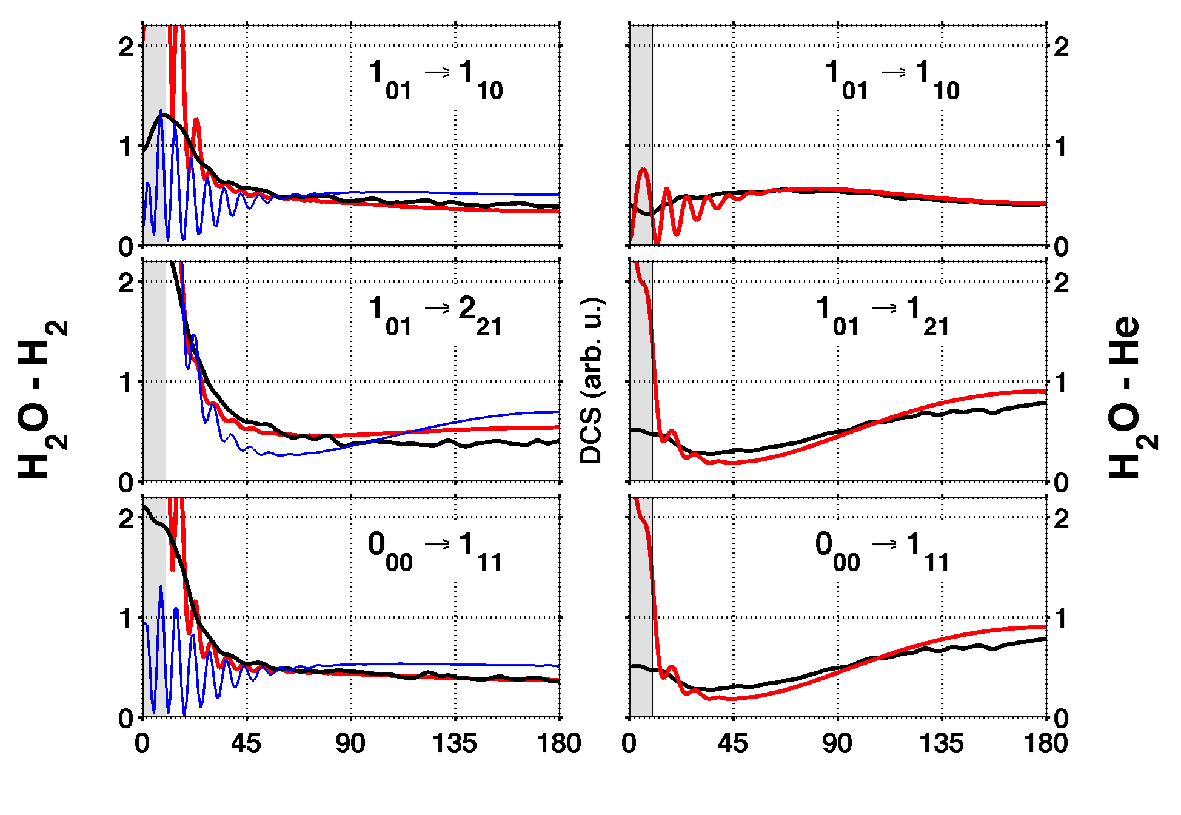
H₂O- H₂ DCS
Theory:
Experiment:
Normalized,
no adjustable parameter
(H₂ J=0,1,2, exp. abundances)
E collision : 574 cm-1
CH Yang et al; J Chem Phys, 2010, 2011

Slide 17
HDO- H₂ DCS
G. Sarma et al. JCP 2013

Slide 18
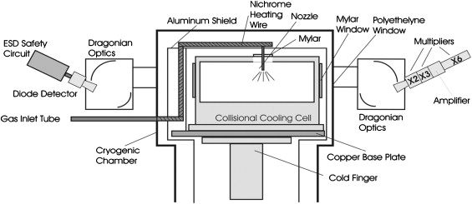
Pressure broadening
Theory
Experimental set up, Drouin et al, JPL
H₂O transition
H₂
The collisions have two effects :
Virtual inelastic scattering
Dephasing of the transition
Result in a spectral line profile + spectral line shift
Approximation of isolated collisions + isolated spectallines.
Fig. 1 Side-view of the collisional cooling experiment. The collisional cooling cell is housed inside the cryogen cell, cooled by a cold finger coupled to a helium cryo-refrigeration system and isolated from the warm cryogen cell walls via an Alu...
Michael J. Dick , Brian J. Drouin , Timothy J. Crawford , John C. Pearson

Slide 19
Pressure broadening and shift,
H₂O in H₂
B. Drouin (JPL), LW, Phys Rev A 2012.
BLACK: Broadening with normal H2;
Green , broadening by para H2.
Lines : theory; symbols: experiments.

Slide 20
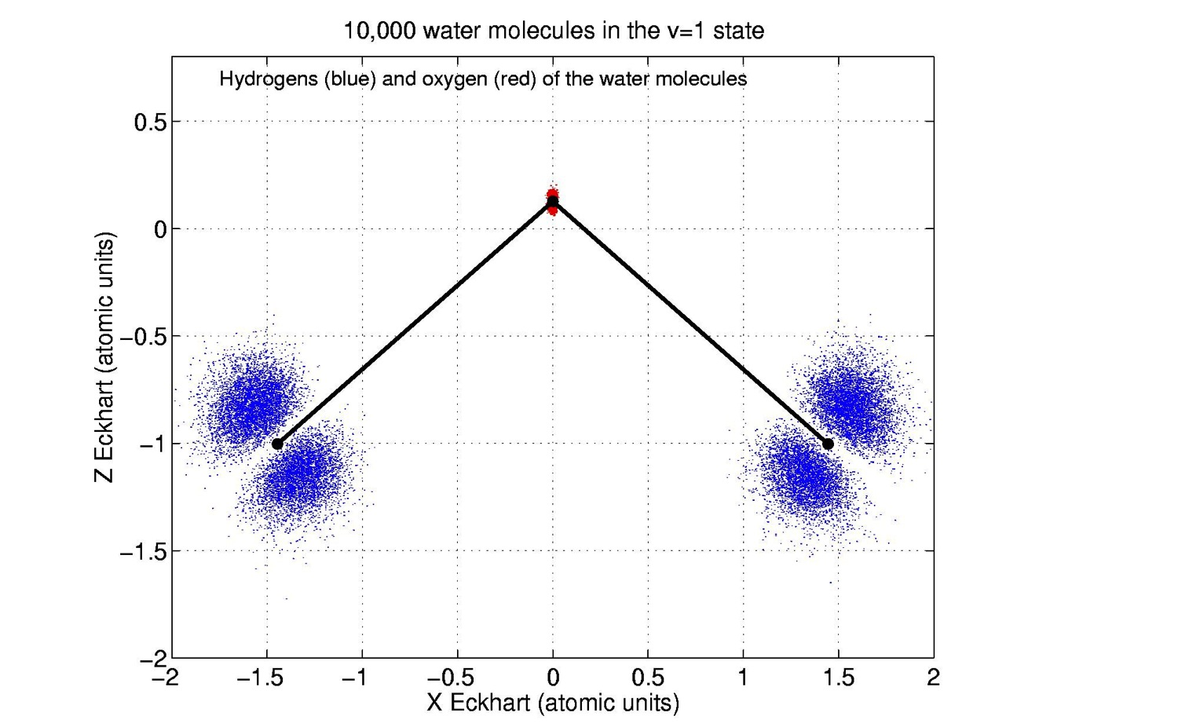
  Vibrational quenching :
  <v=1 | V | v=0> matrix elements
Water in (0,1,0) state

Slide 21
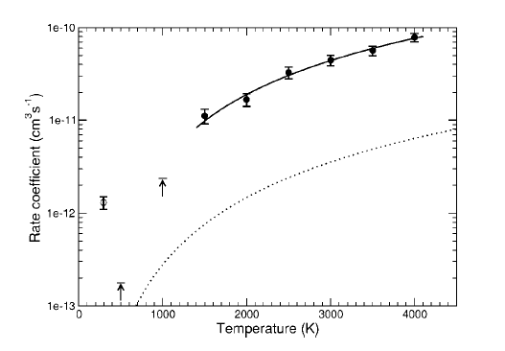
Vibrational quenching v=1 -> v=0
H2O – o-H2
Experiment, 1991
QCT rates, 2006
Quantum rate, first underestimation, full CC 2012
LW, M Gonzalez, J Hutson, in preparation

